Slide 1
Penny Web Hosting in AWS
Host Robust and Scalable Website in AWS for Less
Nikki Yodo

Slide 2



Web Developer
Software Engineer
Consultant
https://nikyotech.com
Cloud Ops Engineer
Notes:
Journey
Experience: Software, DevOps, Cloud Ops engineer
GitHub: https://github.com/nik-yo
LinkedIn: https://www.linkedin.com/in/nikkiyodo/
Consulting: www.nikyotech.com
Email: nikki.yodo@nikyotech.com
Photo by Taneli Lahtinen on Unsplash

Slide 3




Web Hosting
$11.99/mo
AJAX
ASP.NET Web Forms
jQuery
Notes:
Photo by Redd F on Unsplash

Slide 4

Notes:
Photo by Allan Vega on Unsplash

Slide 5
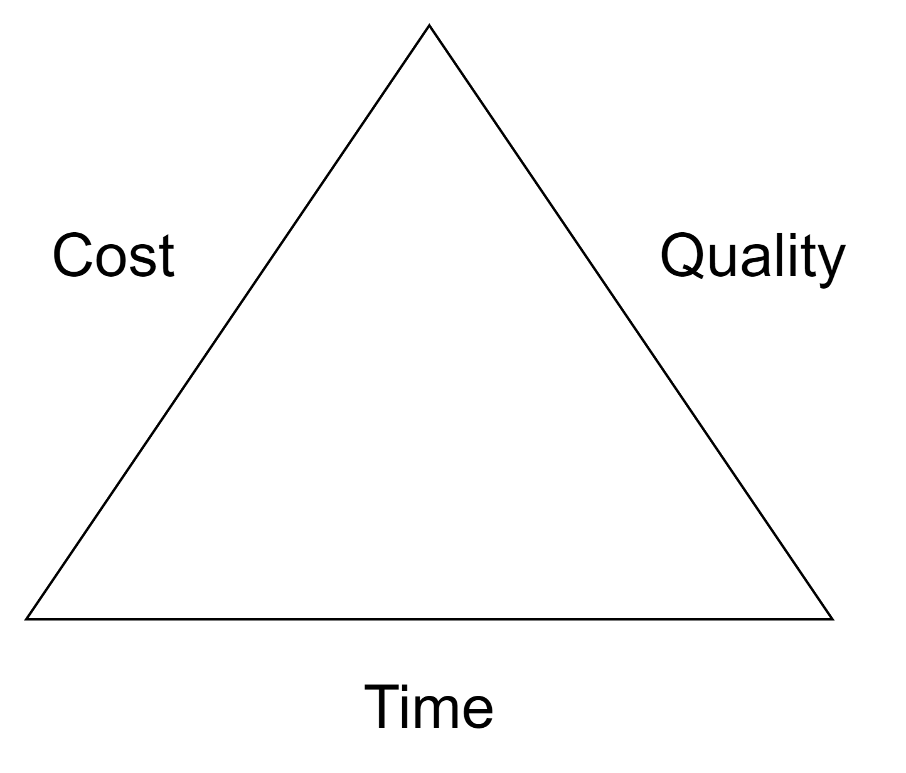
Iron Triangle
Pick 2
Pick 2 3
Notes:
Fast to develop (Time). Cheap to operate (Cost). Reliable and scalable. (Quality). I heard cloud is good for that.

Slide 6




Hosting
Consumption Based Pricing
DDNS
IaC = easy
Home server
F for eFFort
Compute is $$$
Self-hosted
Cloud

Slide 7


Web
Static HTML, CSS, JavaScript
Single Page Application (SPA)

Slide 8






Stack
GitHub Action
GitHub
Amazon S3
Amazon CloudFront
Browser
SSL/TLS Certificate
AWS Certificate Manager (ACM)

Slide 9

Demo
https://bit.ly/awskcug

Slide 10
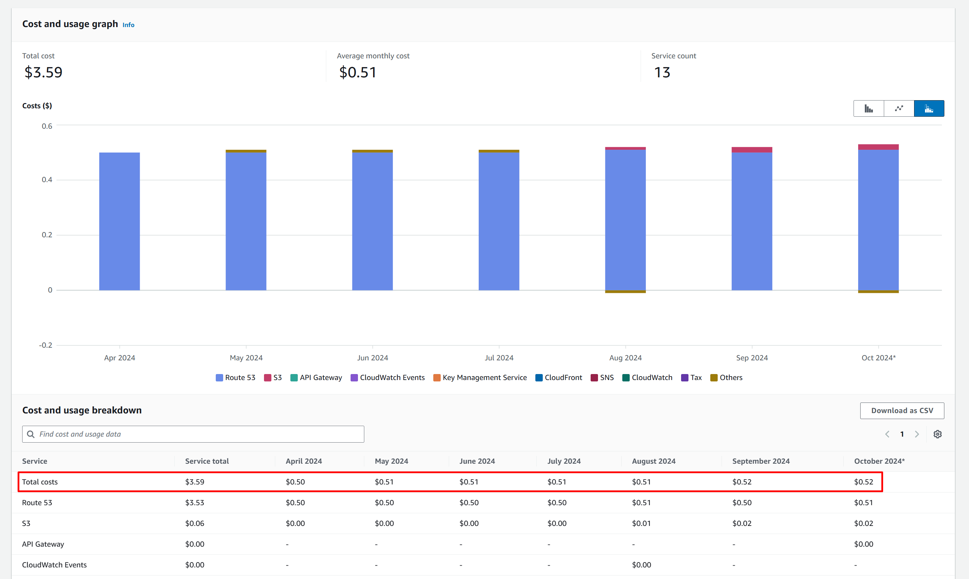

Slide 11

Questions

Slide 12
Backup Slides

Slide 13
Why Next.js?
React/NodeJS based
Support SSG (Static Site Generation)
SEO friendly
Built-in router (folder based)
Support Tailwind CSS (utility first) out of the box

Slide 14
Domain
CloudFlare
Pros:
No extra charge
Cons:
Have to use their DNS
Only need Route 53 for SSL cert validation which is one time setup.
Save $0.50 a month.
https://www.cloudflare.com/products/registrar/

Slide 15
Data
JSON

Slide 16
Backend
Lambda + API Gateway

Slide 17
Database
DynamoDB (on-demand)

Slide 18
Tips
Consumption based pricing
Efficient compute
Serverless

Slide 19
Bonus
Email
Receive: Forward to public email
Send: SES

